Slide 1
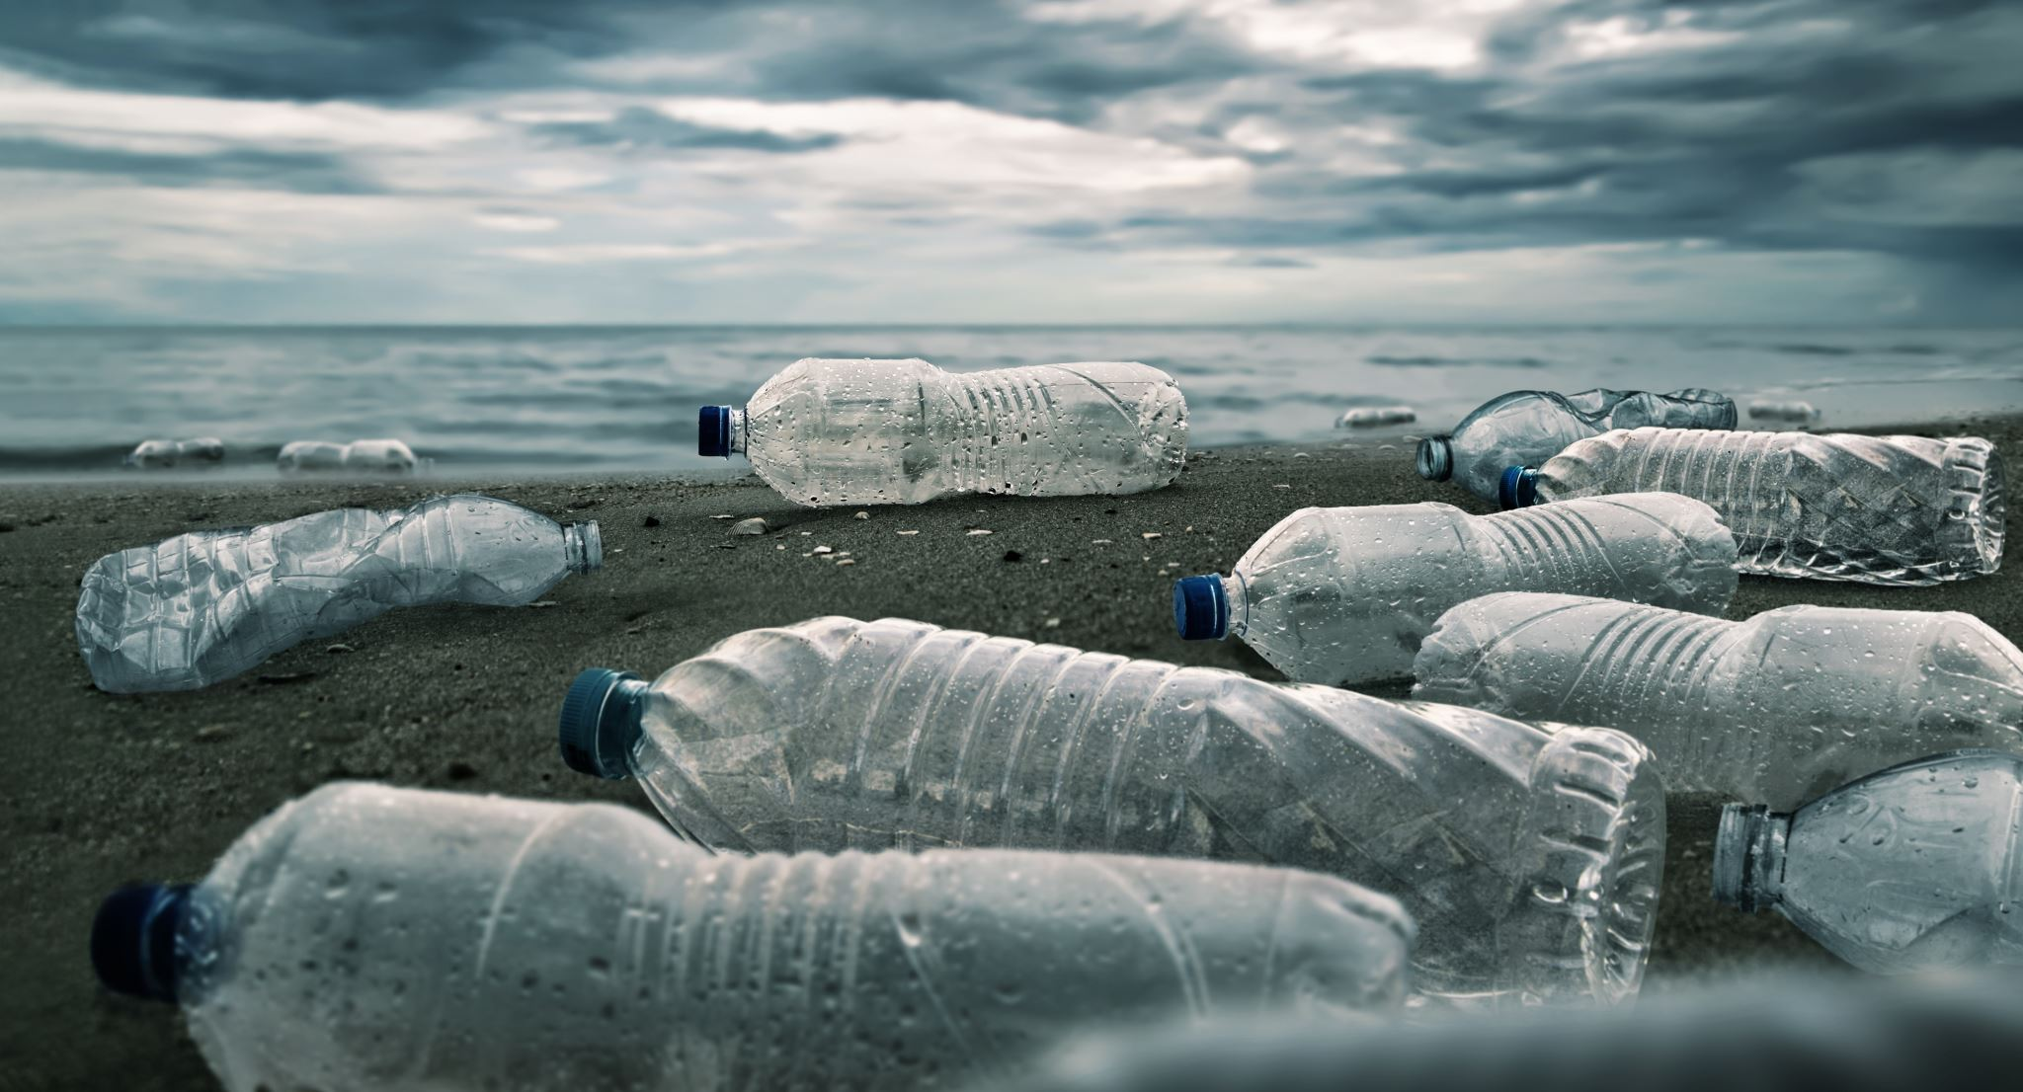
Visualizing the perils of Plastic Pollution 2023

Slide 2
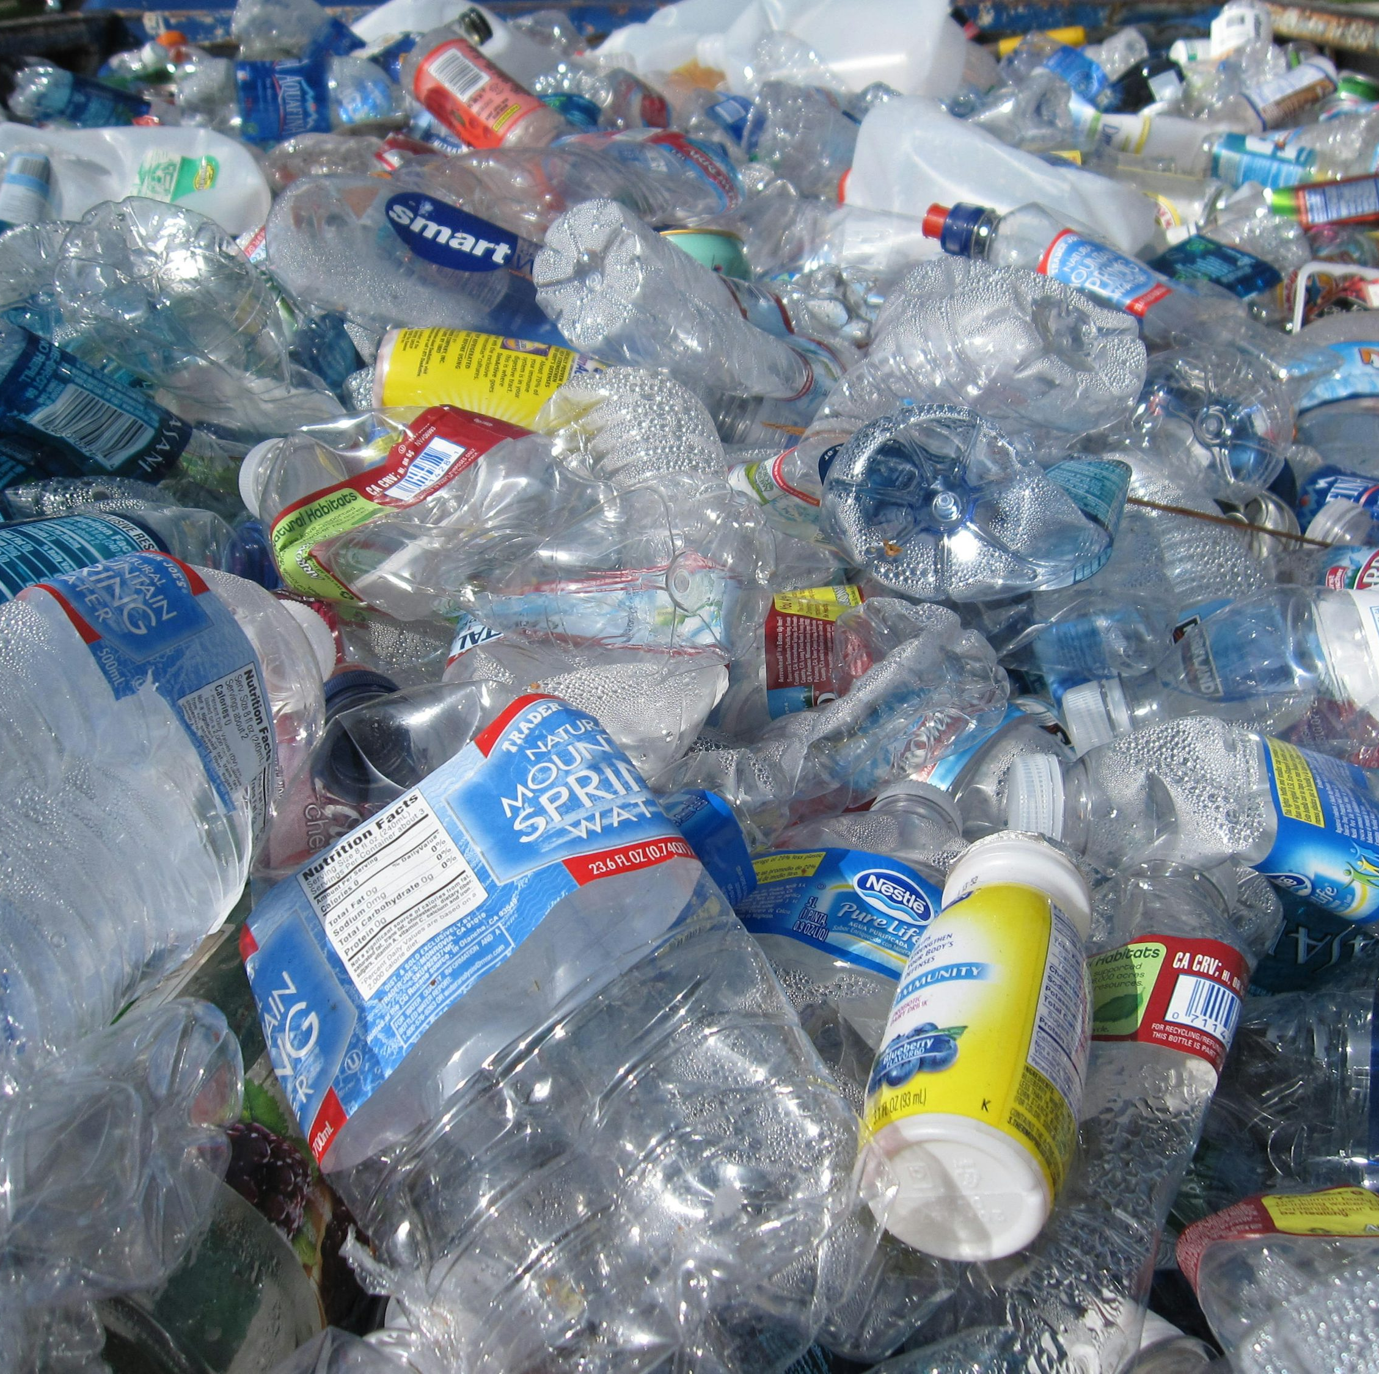
Contents Outline
ABSTRACT
OBJECTIVES
PLASTIC WASTE – AN EMERGING GLOBAL CRISIS
RESEARCH QUESTIONS
METHODOLOGY
KEY FINDINGS VISUALIZED:
A. PLASTIC WASTES
B. RECYCLING
CONCLUSION

Slide 3
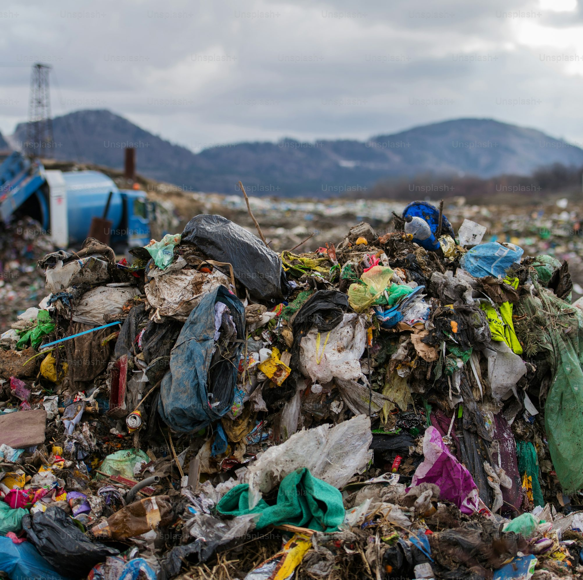
Abstract
Plastic waste poses great peril to human and other life forms.
Uncontrolled plastic waste production across the world
Tons of plastic waste dumped into the oceans and landfills annually
Production rate higher than recycling rate

Slide 4
OBJECTIVES
To highlight the scale and trends of plastic waste pollution; and
To enhance skills/confidence in gathering and processing data for truth telling

Slide 5
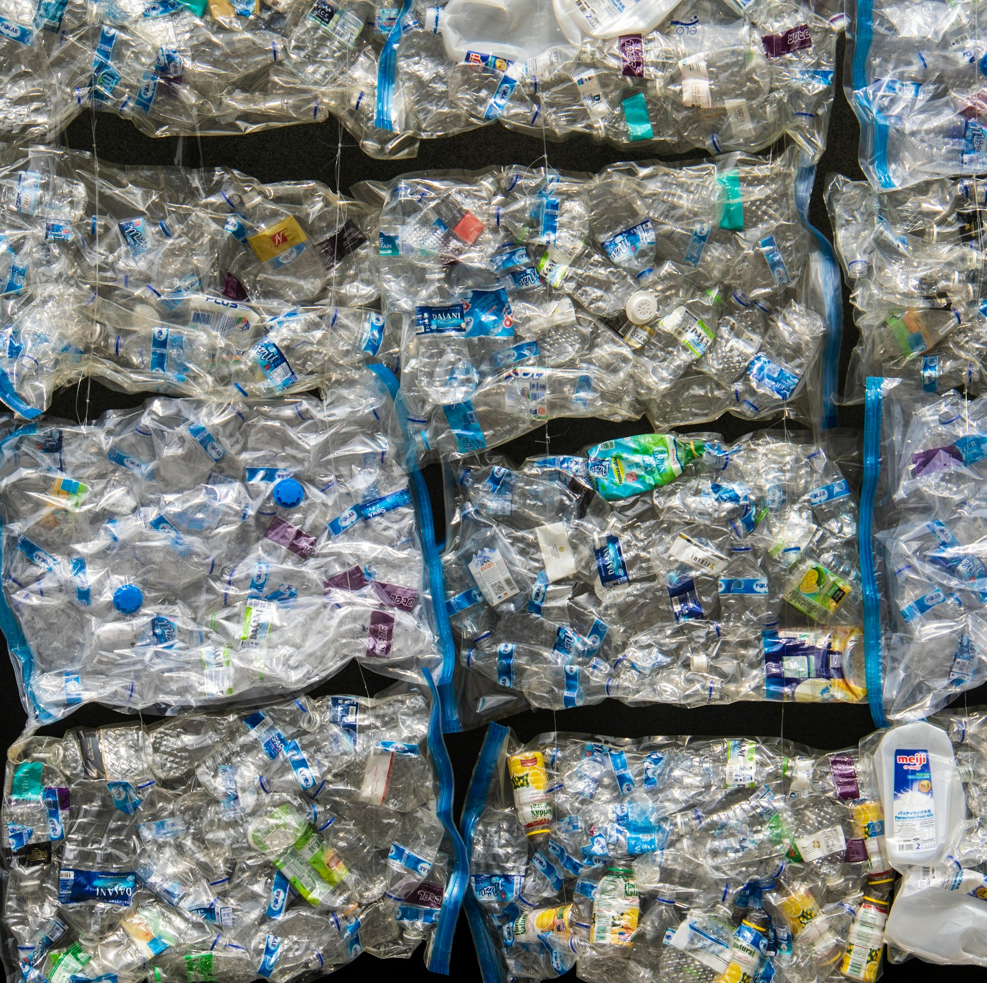
Plastic waste – an emerging global crisis
Here are some of the websites we use for our research
https://www.sas.org.uk/plastic-pollution/plastic-pollution-facts-figures/
Oceans littered with 171 trillion plastic pieces
Ocean plastic pollution an overview: data and statistics
https://www.unep.org/plastic-pollution
12 Facts About Plastic Pollution You Need to Know - Giving Compass
Fast Facts - What is Plastic Pollution? - United Nations Sustainable Development
Earth.Org
Our data source
Global Plastic Waste 2023: Country-wise Data

Slide 6
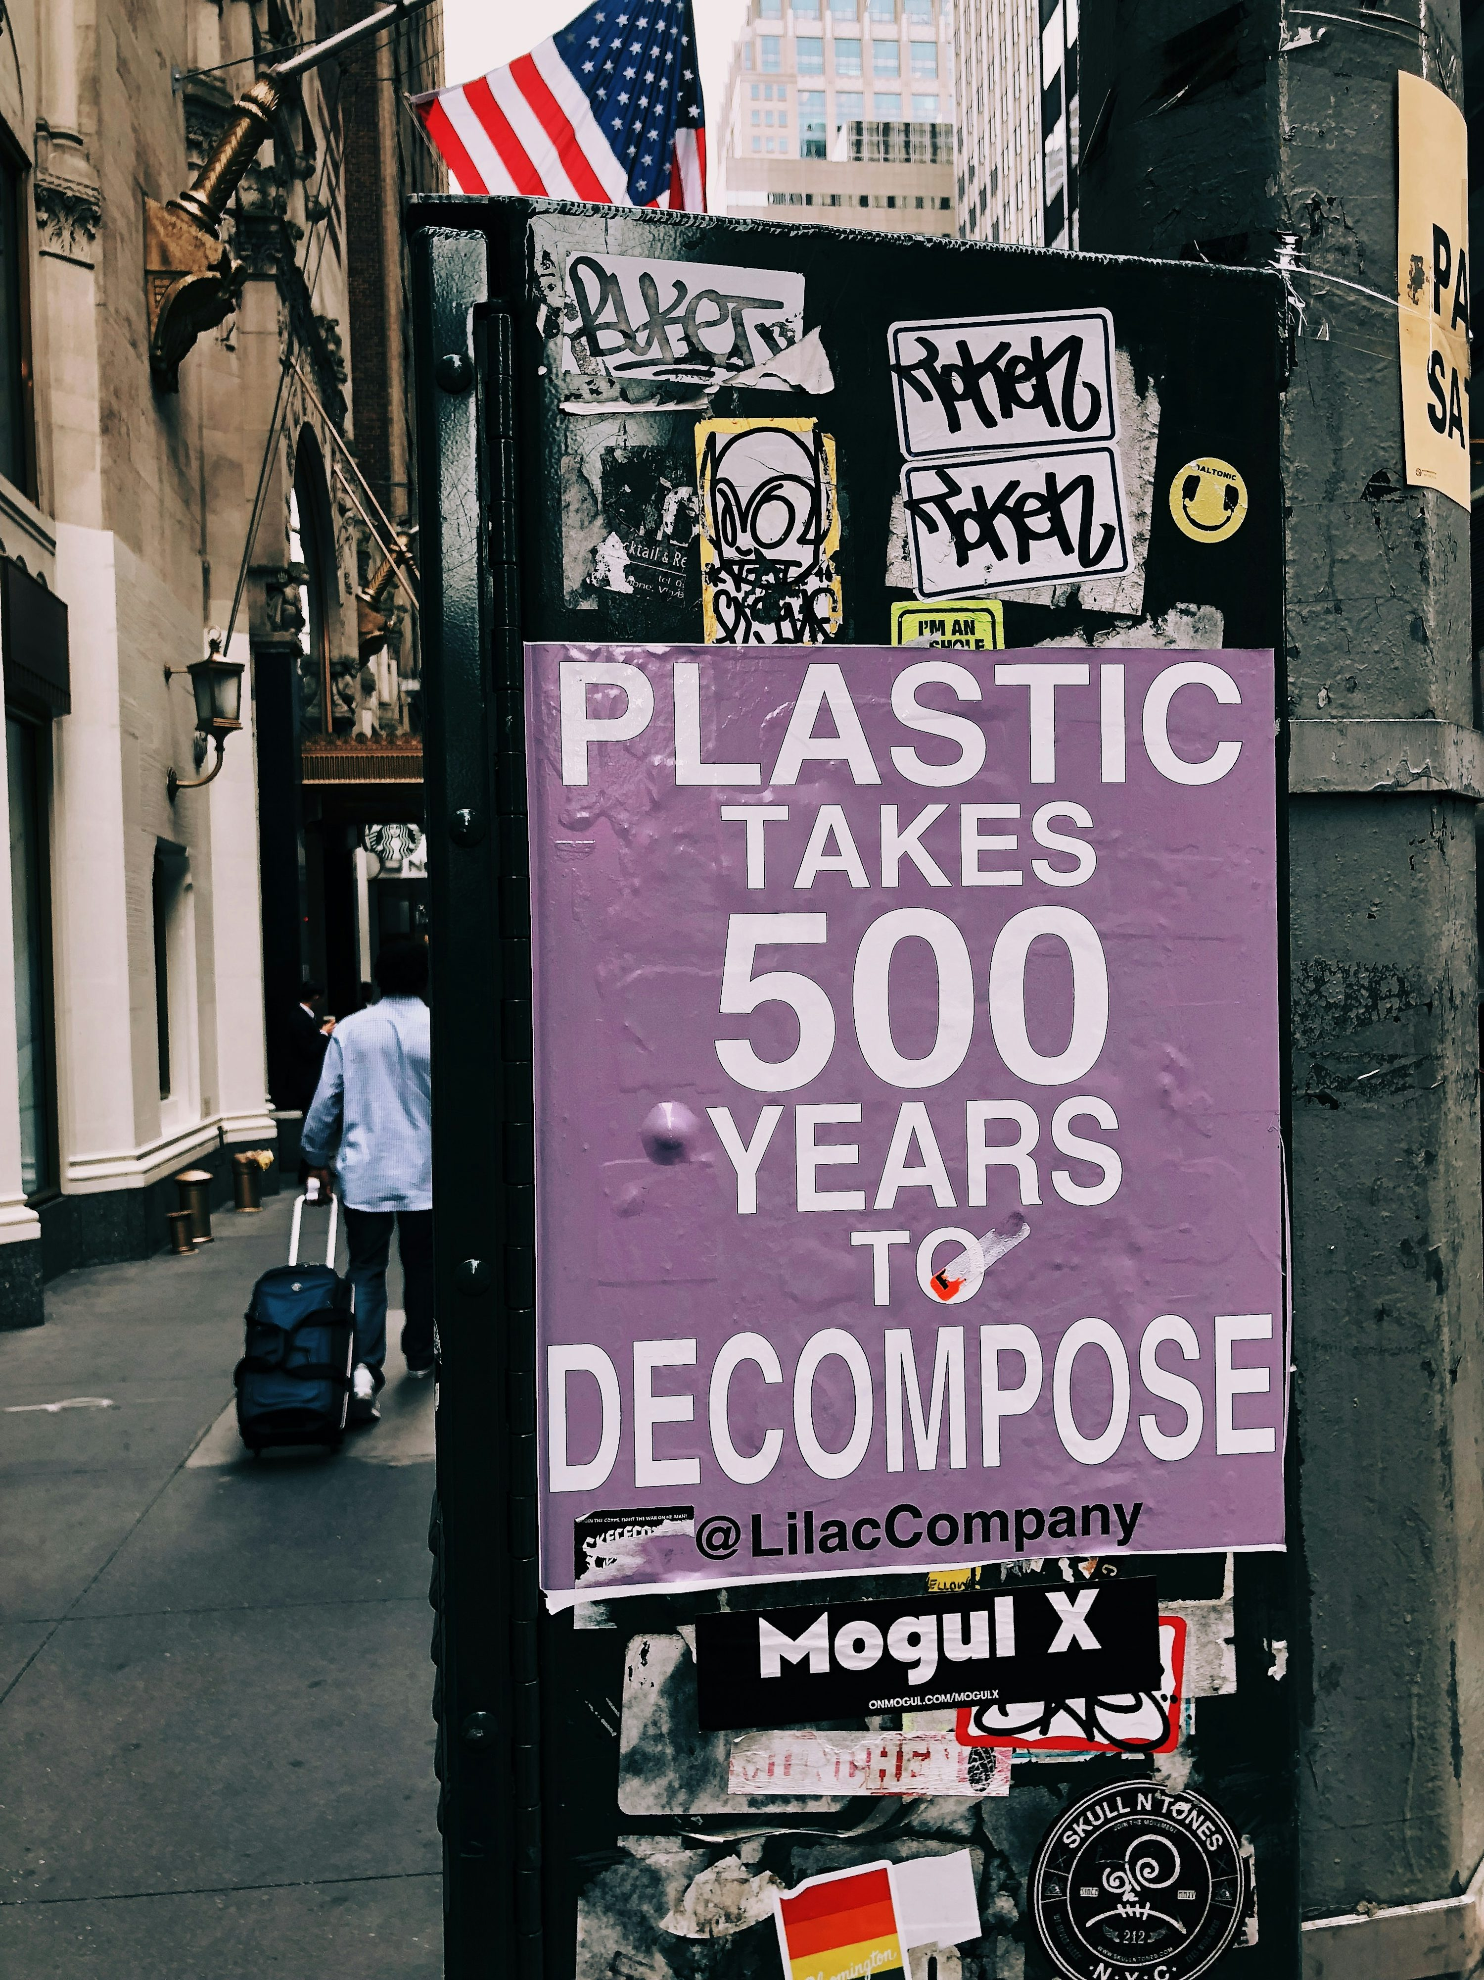
RESEARCH QUESTION
What are the prevailing trends in plastic pollution?
What are the top 10 countries generating the most plastic waste?
What are the top 10 countries recycling plastic waste?
What will be the long-term consequences if plastic pollution is not reversed?

Slide 7
METHODOLOGY
Internet research
Cleaning up the data for accuracy and completeness
Data analysis to identify
limitations,
Setting of parameters and
visualizing the data for
Story telling with consideration for data ethics

Slide 8
Some Facts about plastic pollution
Only 9% of all plastic produced is recycled.
2 million plastic bags are used every minute worldwide.
Every minute of every day, a truckload of plastic is dumped into the ocean.
Every day, the equivalent of over 2,000 garbage trucks full of plastic are dumped into our oceans
One million plastic bottles are bought every minute.
Half of all plastics ever manufactured have been made in the last 20 years.
About eight million tons of plastic waste escape into the oceans from coastal nations every year.
Plastic pollution chokes marine wildlife, damages soil, and poisons groundwater.

Slide 9
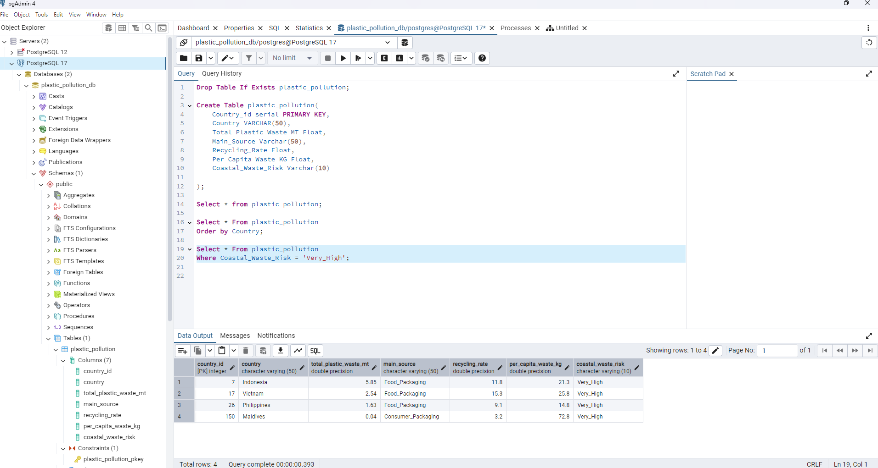
pOstgresql

Slide 10
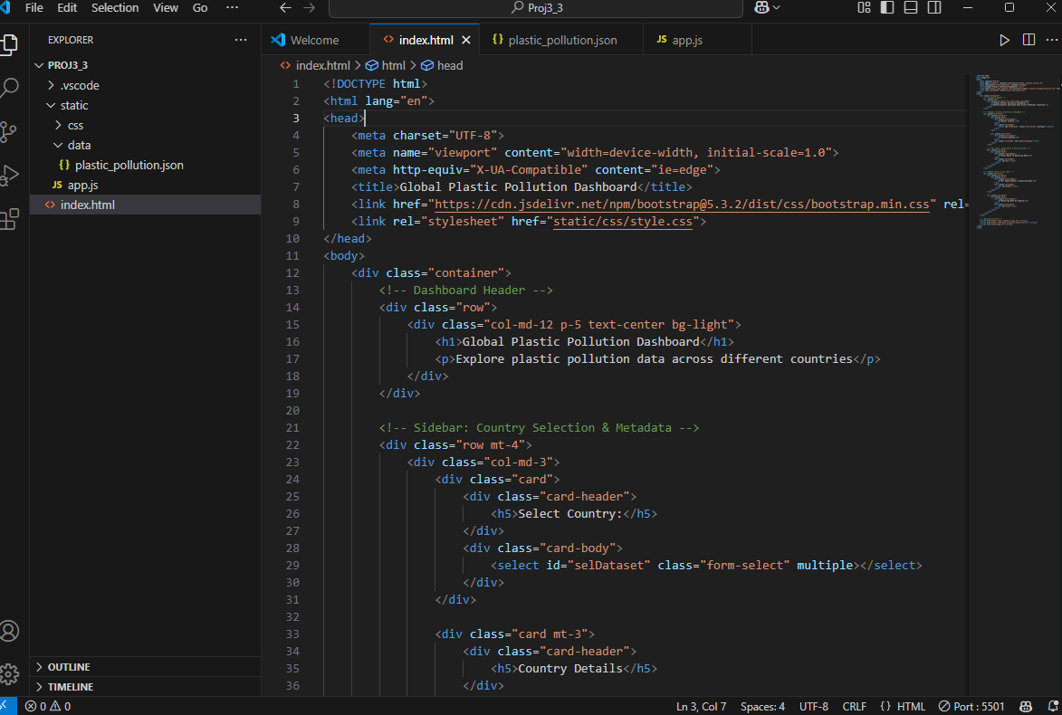
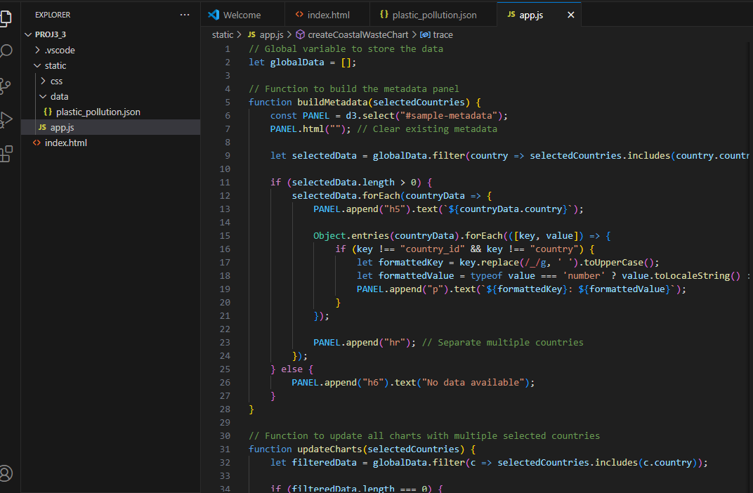
HTML & Java Script

Slide 11
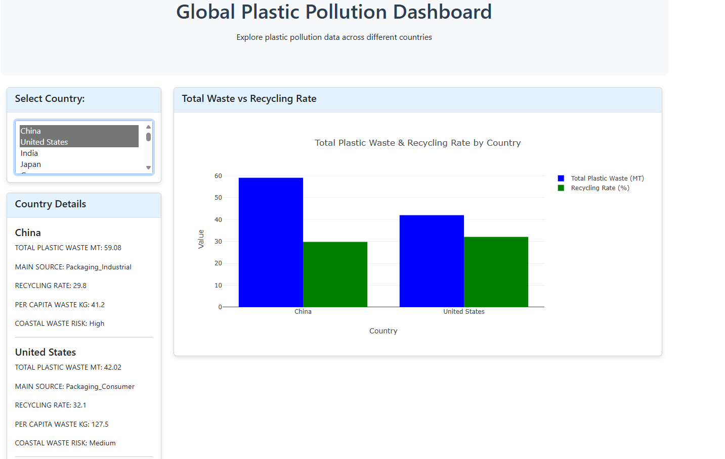
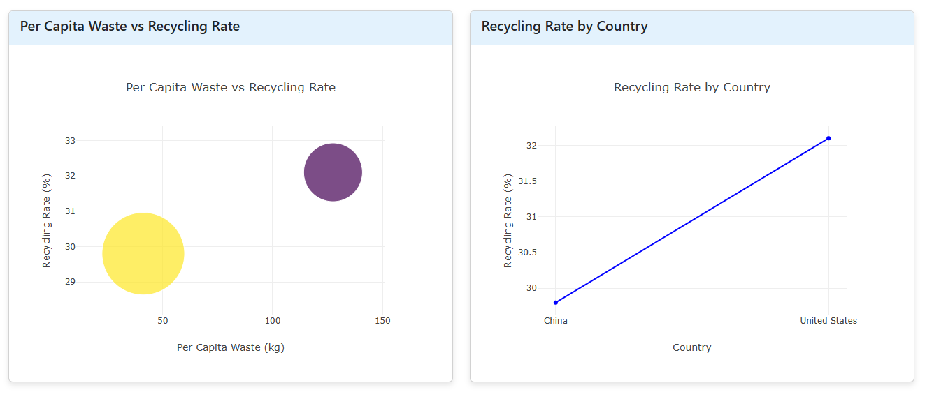

Slide 12
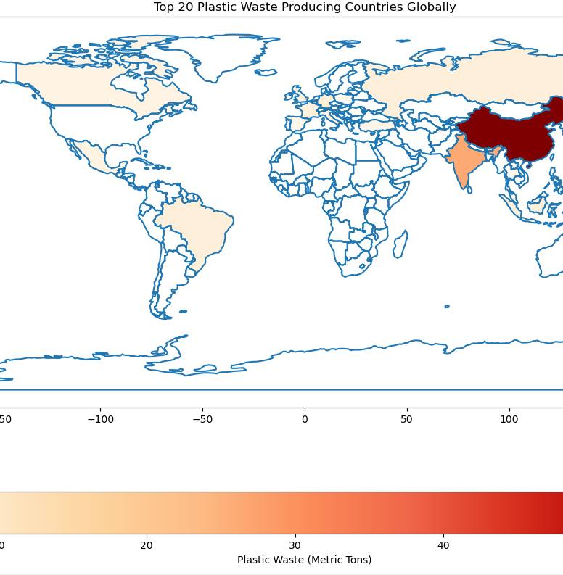
KEY FINDINGS VISUALIZED A. Plastic wastes generated in 2023
Industrialized countries produced the most plastic wastes in 2023

Slide 13
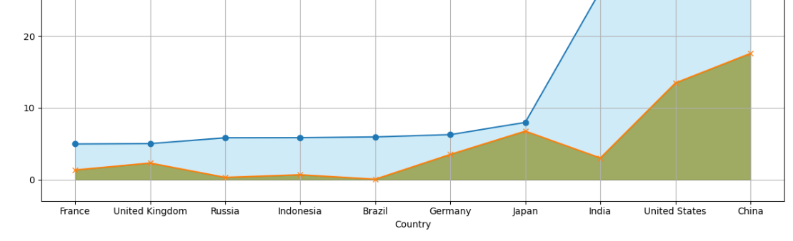
KEY FINDINGS VISUALIZED
Plastic waste production exceeded plastic waste recycling in 2023

Slide 14
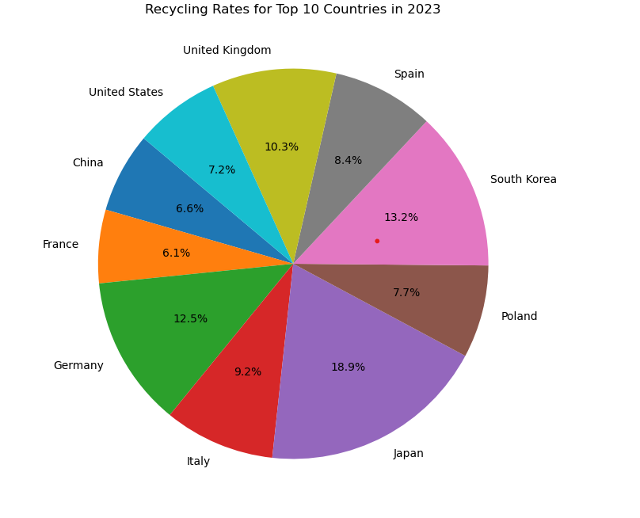
B. PLASTIC WASTES RECYCLING
Japan had the highest recycling rate – at 84.8 % of the total plastic wastes it generated in 2023
France had the least recycling rate – at 27.3 % of the total plastic wastes it generated in 2023

Slide 15
Suggestion
Avoid single-use
Take a cloth bag when you go shopping
Replace plastic Tupperware for glass or steel containers
Use a refillable water bottle
Compost food waste to avoid plastic garbage bags
Recycle

Slide 16
CONCLUSION
Limitations in data – accessing plastic waste data proved difficult
Further and expanded research could reveal more comprehensive trends pre and post 2023
Plastic waste poses serious perils to the planet, and more progressive steps must be taken to reverse the existing trends

Slide 17

THANK YOU.
QUESITONS

